Slide 1
Past Simple
Irregular verbs

Slide 2

Irregular verbs make the past form in different ways.
Ex: go - went
eat - ate
take - took

Slide 3
Negative sentences
Subject + didn’t + infinitive
Ex: You didn’t buy tickets for the concert.

Slide 4
Interrogative sentences
Did + subject + infinitive
Ex: Did she buy a CD?

Slide 5

Ask and answer. Follow the model.
❐
Michael / do / his homework?
Did Michael do his homework?
Yes, he did.

Slide 6

x
Ann / eat / pizza?
Did Ann eat a hamburger?
No, she didn’t. She ate salad.

Slide 7

❐
they / win / the game?
Did they win the match?
Yes, they did.

Slide 8
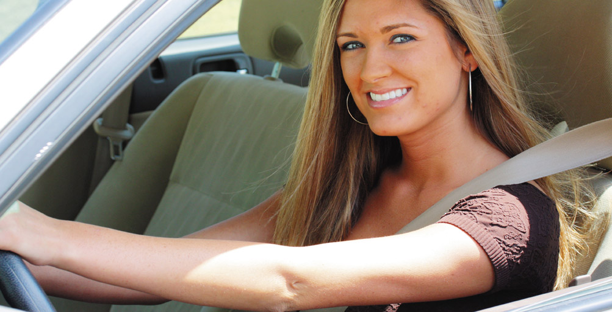
x
Sue / catch / the bus to work?
Did Sue ride her bike to work?
No, she didn’t. She drove to work.

Slide 9
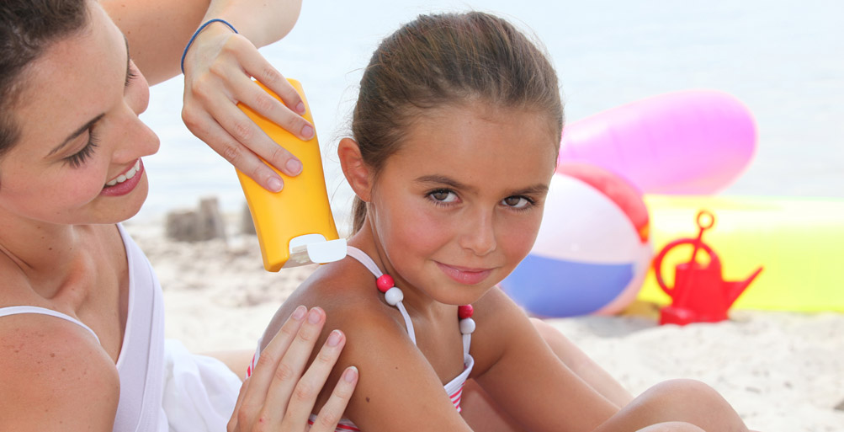
❐
they / go / to the beach?
Did they go to the beach?
Yes, they did.

Slide 10
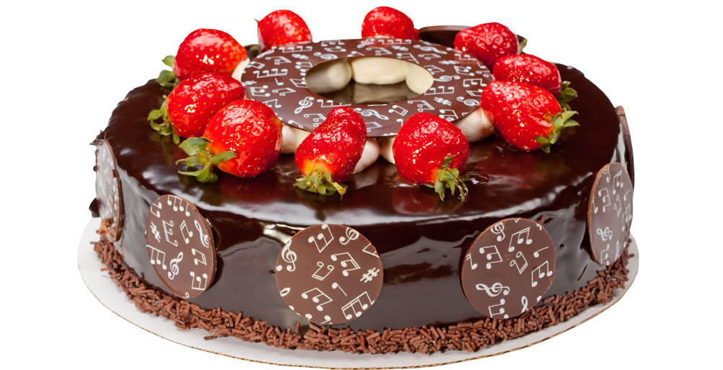
x
you / make / an apple pie?
Did you make an mince pie?
No, I didn’t. I made a chocolate cake.

Slide 11

❐
Peter/ buy / a new camera?
Did Peterbuy a new camera?
Yes, he did.

Slide 12

x
Maggie / drink / water?
Did Maggie drink beer?
No, she didn’t. She drank orange juice.

